Slide 1
ADVANTAGES OF AUTOMATION
-By Saurabh Dimri

Slide 2


Why automation
Fast pace and quick releases
Less work more throughput
Reduce amount of error

Slide 3
Impact of automation
Automation has had a notable impact in a wide range of highly visible industries beyond manufacturing.
Once-ubiquitous telephone operators have been replaced largely by automated telephone switchboards and answering machines.
Medical processes such as primary screening in electrocardiography or radiography and laboratory analysis of human genes, cells, and tissues are carried out at much greater speed and accuracy by automated systems.

Slide 4
Automation : king of all stages in software development
For a repeated task a bot can do that for you.
Stress-testing a core system and want to really catch all those bugs? Automate it.
Coding similar functionality across a few different projects at the same time? Automate it.
IF the DEVS need to do any task again and again just AUTOMATE THE HELL OUT OF IT!!!!!

Slide 5
THE glory continues
Regardless of what kind of apps you’re planning on developing (or outsourcing if that’s more your speed), you’ll probably need some infrastructure to test and host the software. And all of that hardware needs to be running the same operating systems and software in the same way – especially if you want to scale.
One server doesn’t update and knocks the entire system off-line
A major server upgrade forces your devs to scan dozens of config files looking for the most up-to-date one

Slide 6
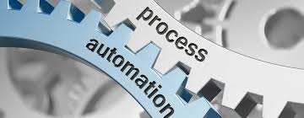
Advantages
Reduce Production Cost
Decrease in Part Cycle Time
Improved Quality and Reliability
Better Floor Space Utilization
Reduce Waste
Stay Competitive

